Slide 1
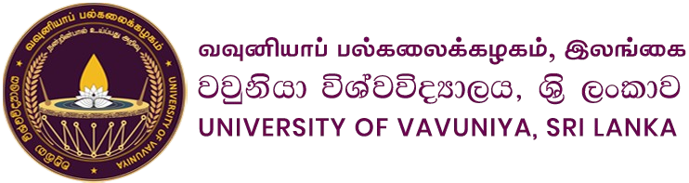
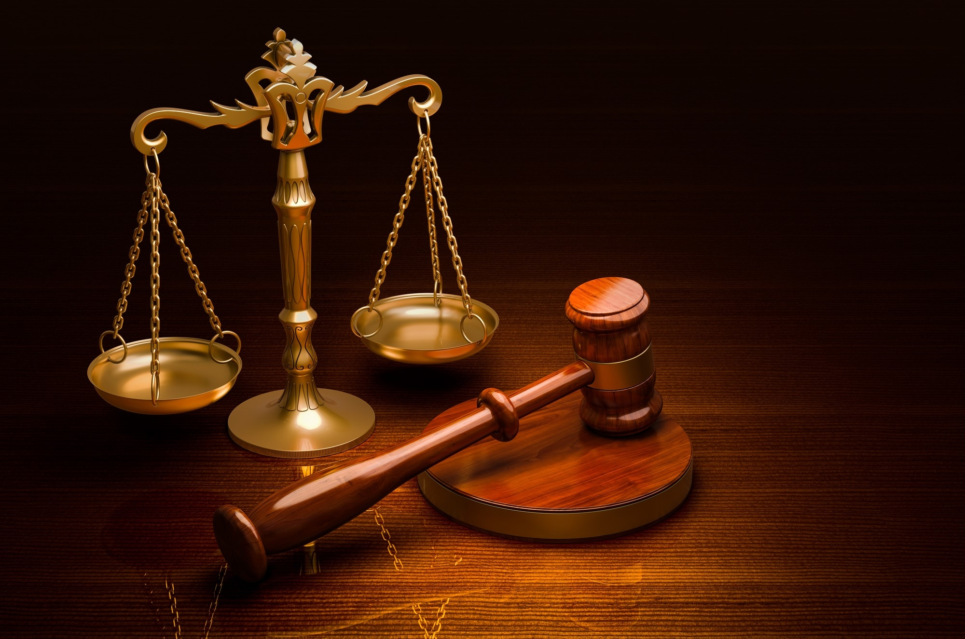
Court Hierarchy in Sri Lanka.
Social and Professional issues in IT Continuous Assessment – 02
Group-J

Slide 2

Our Today’s Topics
Supreme Court
Court of Appeal
2
1
High Court
District Court
3
4
Magistrate Court
5

Slide 3
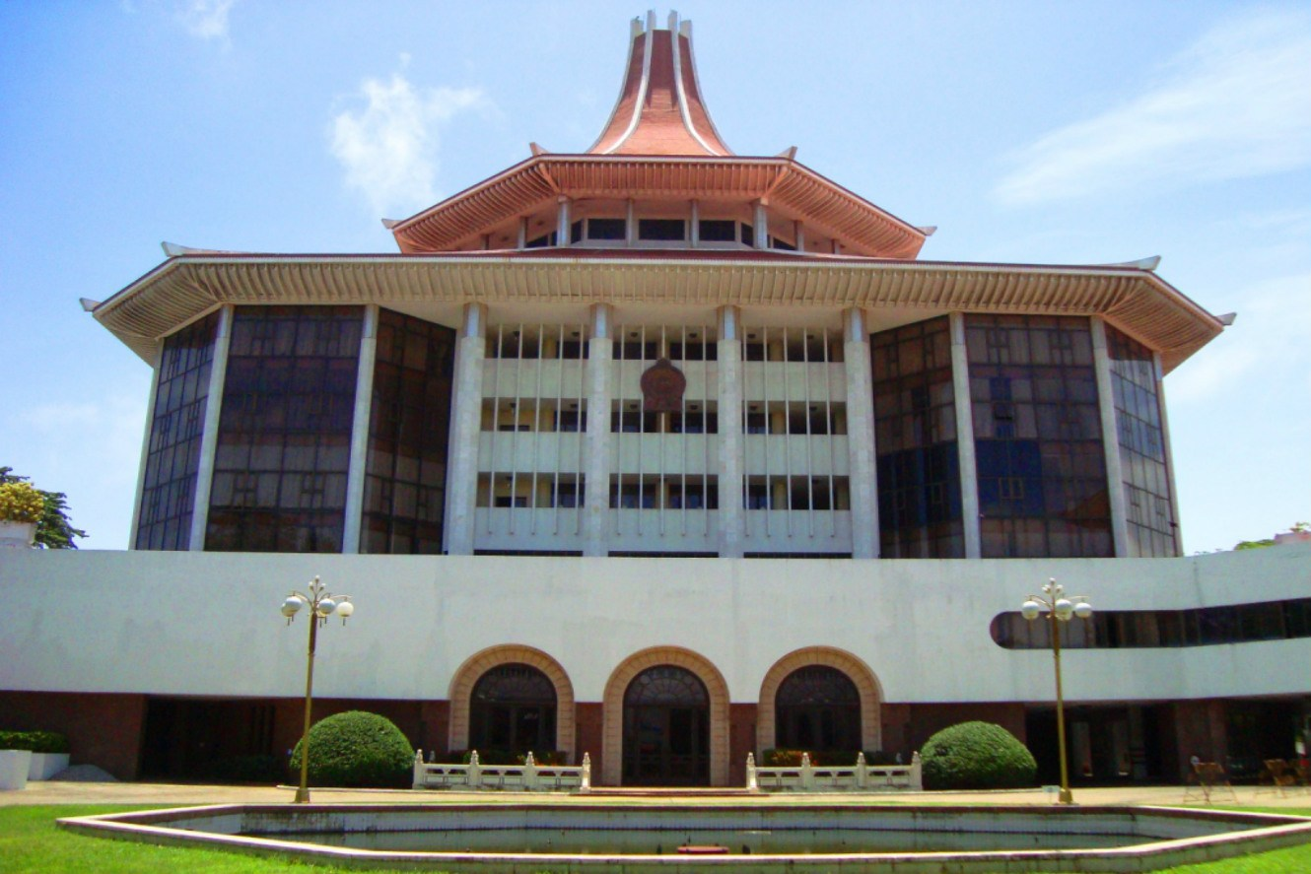
1. Supreme Court
What is?
The Supreme Court is the highest judicial authority. It ensures the interpretation of the Constitution and oversees the protection of fundamental rights.
Cases Handled:
Constitutional matters.
Fundamental rights violations.
Appeals from lower courts.
Penalties:
Supreme Court of Sri Lanka
Confirms orders compensation for fundamental rights violations, or imposes revised sentences.

Slide 4
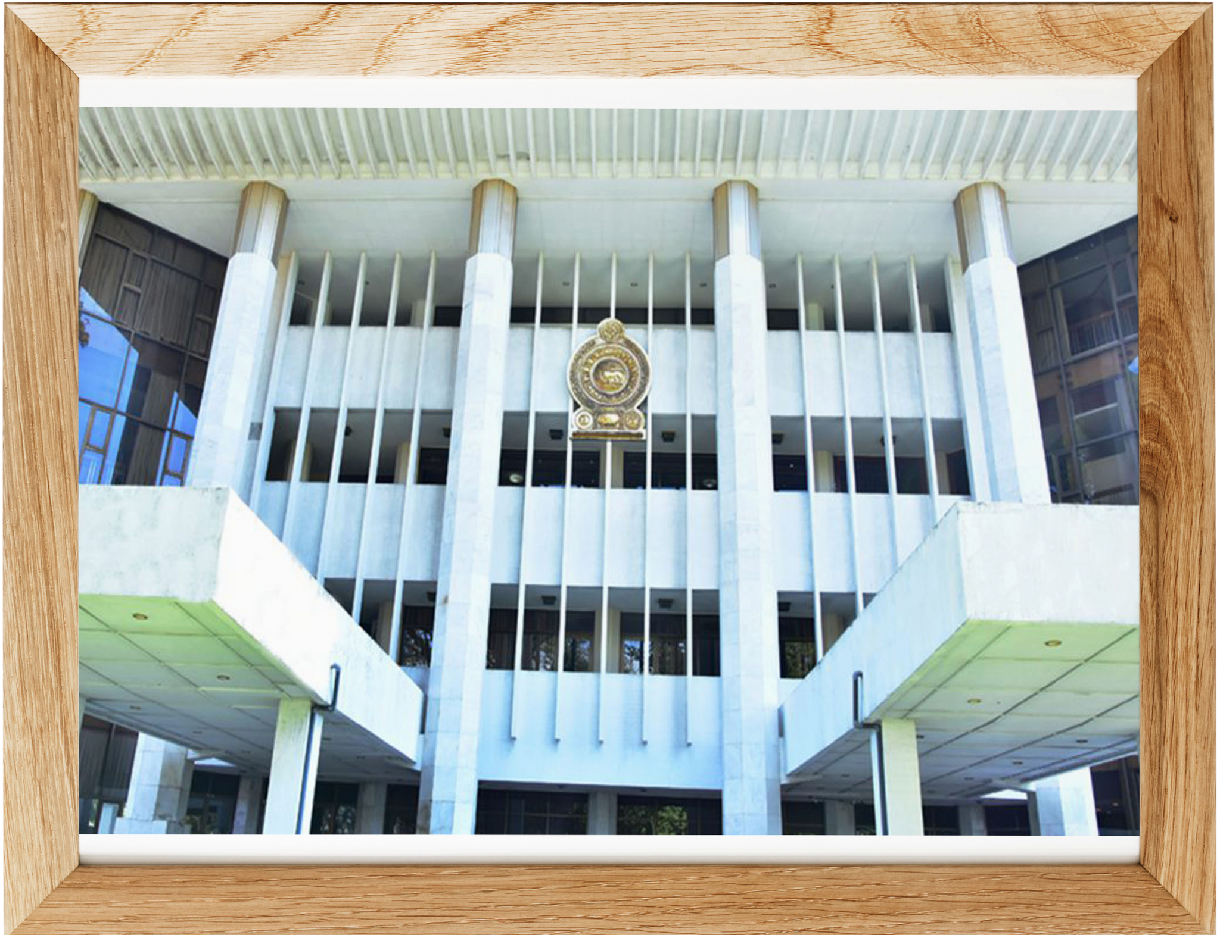
2. Court of Appeal
What is?
The Court of Appeal of Sri Lanka is the second most senior court in the Sri Lankan legal system, with only the Supreme Court of Sri Lanka above it.
Cases Handled:
Appeals against decisions of the High Court.
Writ applications such as habeas corpus.
Penalties:
Court of Appeal Sri Lanka
Modifies sentences or awards compensation for administrative law violations.

Slide 5
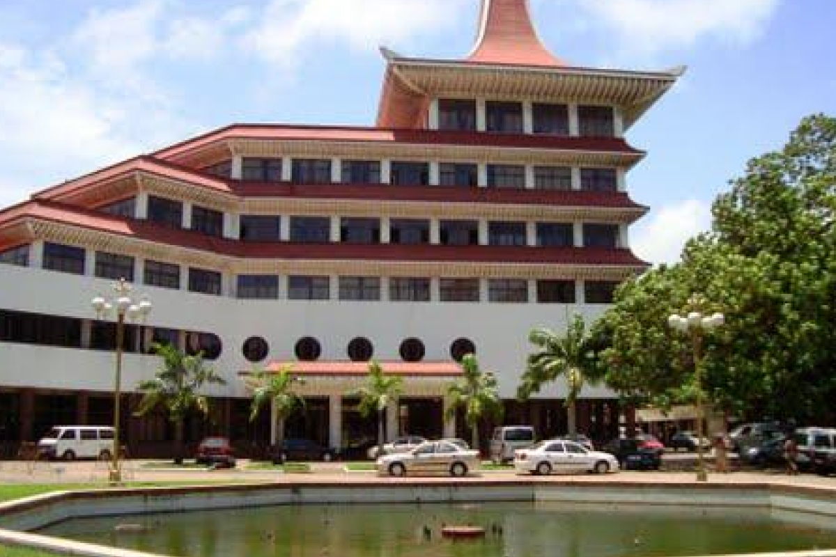
3.1 Commercial High Court
What is?
The jurisdiction of the Commercial High Court is to hear actions where the cause of action has arisen out of commercial transactions in which demand exceeds fifty million Sri Lankan rupees.
Cases Handled:
Corporate Fraud.
Intellectual Property Violations.
Banking and Financial Crimes.
Penalties:
The Commercial High Court Of Colombo
Imposes large financial penalties or orders imprisonment for commercial law violations.

Slide 6
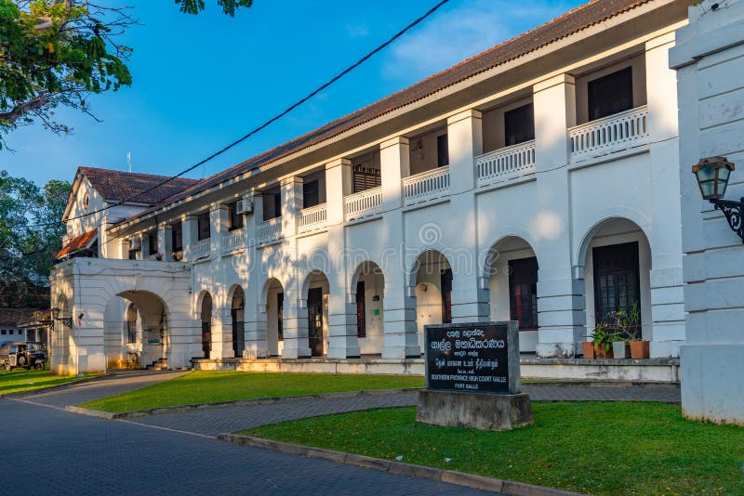
3.2 High Court of the Provinces
What is?
The Provincial High Court operates within each province, ensuring the efficient administration of justice closer to the people. Provincial High Court handles serious criminal cases.
Cases Handled:
Major Crimes:
Homicide (murder).
Sexual offenses (rape).
Appeals in Criminal Cases.
Penalties:
Galle High Court
Confirms imprisonment or compensation for criminal cases.

Slide 7
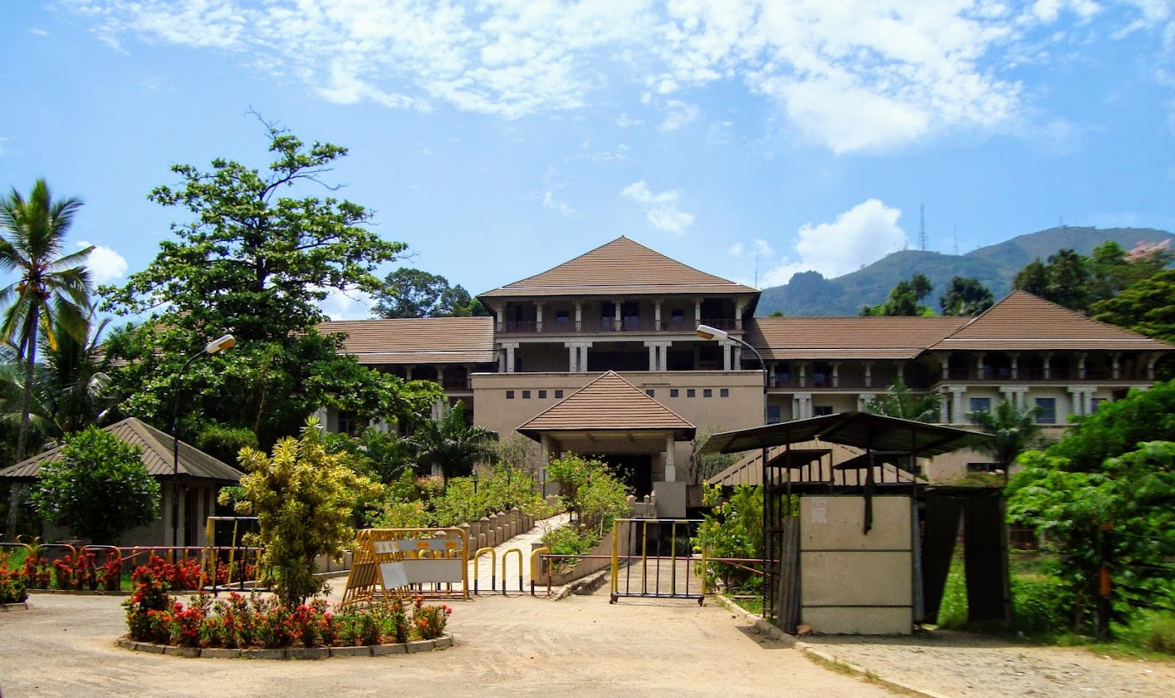
4. District Court
What is?
The District Court plays a vital role in addressing specific criminal cases with civil implications, such as defamation or cases involving compensation for bodily harm.
Cases Handled:
Cases Involving Compensation for Criminal Acts.
Probate and Testamentary Matters with Criminal Aspects.
Penalties:
Kandy District Court
Orders property division, child custody, or compensation for civil cases linked to criminal acts.

Slide 8
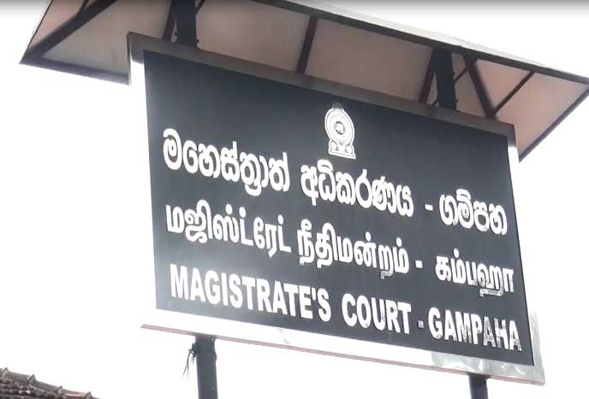
5. Magistrate Court
What is?
The Magistrate Court is the lowest tier in Sri Lanka's judicial hierarchy and handles minor criminal cases and civil disputes. Its localized setup ensures speedy justice for common and smaller-scale offenses.
Cases Handled:
Minor Offenses:
Theft, trespass, and simple assault.
Traffic Offenses
Penalties:
Gampaha Magistrate Court
Issues fines, short-term imprisonment, or community service for minor offenses.

Slide 9


Our Team
A
A
A
Chathuranga
Sivosan
Janani
2019/ICTS/67
2019/ICTS/68
2019/ICTS/69
A
A
A
Sasangi
Tharsha
Mokshya
2019/ICTS/70
2019/ICTS/71
2019/ICTS/73

Slide 10


Q & A
Have Questions About the Court Hierarchy? Let's Clarify and Discuss Together!

Slide 11

Thank You!
Thank You for Your Attention!

